Slide 1


Digital University Theses, Publications and Staff
Milena Atanasova
milena.atanasova@studenti.unitn.it
Knowledge Graph Engineering 2022/2023 UniTrento
December 2022
Project GitHub repository: https://github.com/atanasova16/TrentinoDUniTPS

Slide 2
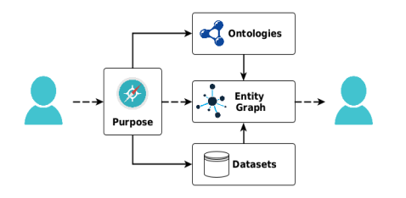
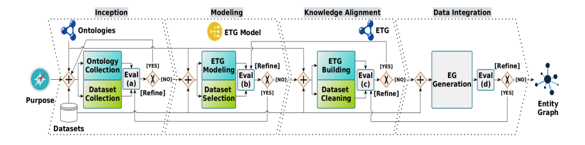
iTelos methodology
01. Purpose and Domain of Interest
05. Informal modeling
02. Resources
06. Formal modeling
03. Purpose Formalization
07. Outcome exploitation
04. Inception
08. Conclusions and open issues

Slide 3

Purpose and DoI
“A service which help the users to query and know about the different areas of academic and research interest being pursued at the University of Trento”
Academics at the University of Trento, including information mainly about research activities, between the years 2020 and 2022

Slide 4
Project Resources
Knowledge Sources | VIVO | FOAF | Schema.org | IAO | DCAT
Data Sources | Theses (Open Data Trentino) | Publications (Open Data Trentino) | Staff (Open Data Trentino) | Courses (Open Data Trentino) | Digital Portal of UniTn
Software Used | Python (Visual Studio Code) | Protégé | Karma data linker | KOS | Shapeness | GraphDB

Slide 5

Purpose Formalization

Slide 6
Purpose Formalization
Scenarios
Identify a context in which the KG would be used
Concern time (w.r.t. academic year), place
Personas
Users who would benefit from the KG and would like to learn something from it
11 characters, different age, occupation, nationality
Competency questions
A person in a scenario asks a query to be fulfilled by the KG
For each person, 4 to 6 questions
Overview

Slide 7
Purpose Formalization
Spring, school year, familiar with UniTN, Italy
Summer, before start of school year, familiar with Unitn, outside Italy
Spring, school year, already inside Unitn, Italy
Autumn, beginning of school year, already inside Unitn, Trento, Italy
Summer, before start of school year, not familiar with Unitn, outside Italy
Spring, school year, not familiar with Unitn, outside Italy (EU)).
Winter, school year, familiar with Unitn, Italy
Scenarios
Aim to provide context for different uses of the knowledge graph.

Slide 8
Purpose Formalization
Personas
Marco Pierotti
Age: 19, Nationality: Italian
Occupation: high-school student
Description: Exploring study opportunities
Elena Ranzani
Age: 25, Nationality: Italian
Occupation: Assistant in biology UniTN
Description: Wants to do a PhD
Donatello Ferrari
Age: 63, Nationality: Italian
Occupation: Full-time professor in Psychology
Description: Looking for students/alumni to help him for his project
Ivan Krumov
Age: 21, Nationality: Bulgarian
Occupation: Bachelor graduate
Description: Doing project in AI and is looking for information and help
Ginnie Anderson
Age: 32, Nationality: British
Occupation: editor in a Maths journal
Description: Looking for innovative maths-related articles to include and offer to people
Paolo Lanza
Age: 44, Nationality: Italian
Occupation: Investor
Description: Passionate about Physics, wants to organize a conference

Slide 9






Purpose Formalization
Competency Questions
Theses from different degrees and their count?
Publications to help a PhD research?
Courses of study at UniTN? Departments information?
Authors of publications for AI?
Students and advisors for theses in Biology?
Biology publications?
A way to contact such people?
Most prominent researchers in several fields?
Professors at Physics department?
Students who’ve written theses in Psychology? For which degrees?
Access point to math publications’ full text?
Articles only in English?
Courses grouped by faculties and most prominent ones?

Slide 10
Inception

Slide 11
Inception phase
Data management
1. Separating nested structured datasets
4. Datasets as output informal resources:
Extracting students, supervisors, co-supervisors, examiners from Theses
Extracting files from publications
Extracting positions from staff
Theses
Students
Supervisors
Co-supervisors
Examiners
Publications
Files
Authors
Staff persons
Positions
Degrees
Departments
2. Dealing with IDs
12 datasets as semi-formal resources to be utilized as input in the next phase. Format: CSV and JSON
Creation when not available
Refined at Data Integration phase regarding the concept of URIs and Identification sets
3. Departments and Degrees
Departments data was scraped from the Digital University Portal
Degrees were extracted from the Courses distribution and then linked to theses and departments

Slide 12
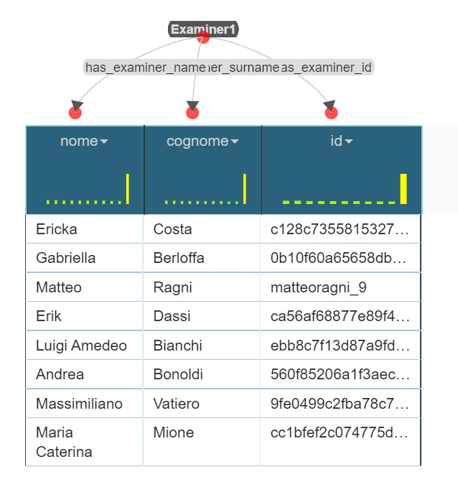
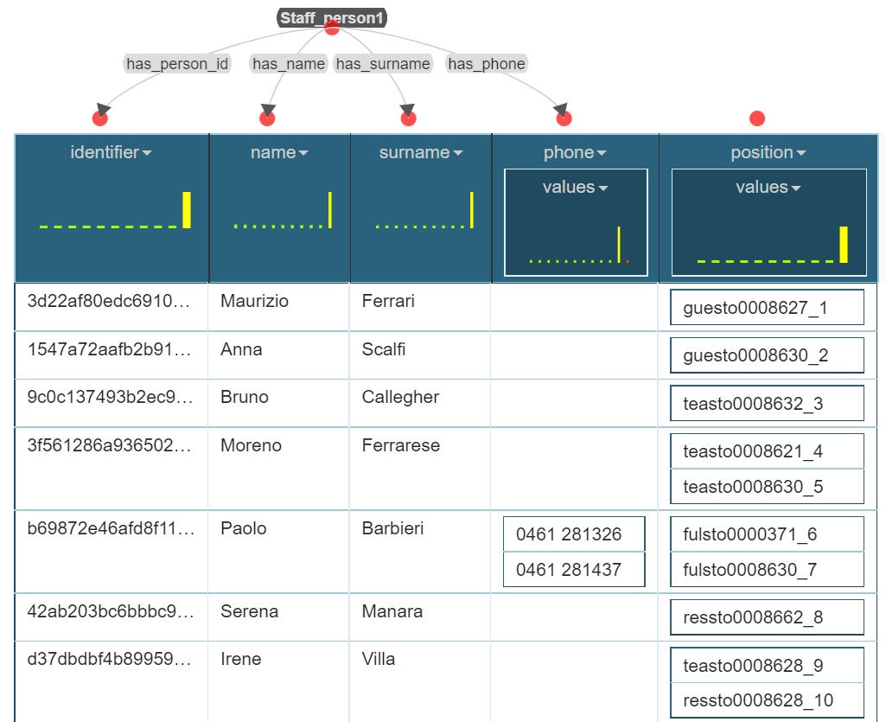
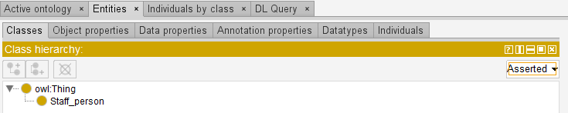
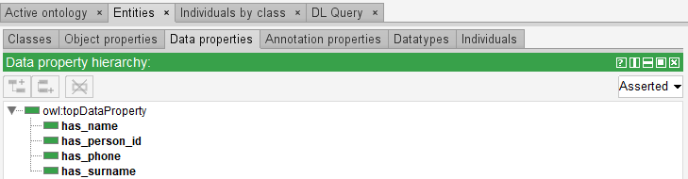
Inception phase
Single datasets ontologies
Using Protégé, small ontologies were defined for each dataset. Each one represents an entity, with the data properties present as fields from the dataset files, keeping those fields which are useful for the purpose.
Later, those were imported in Protégé to link with object properties and create the teleology.
Using Karma Data Linker, these small ontologies were mapped to the datasets.

Slide 13
Informal Modeling

Slide 14
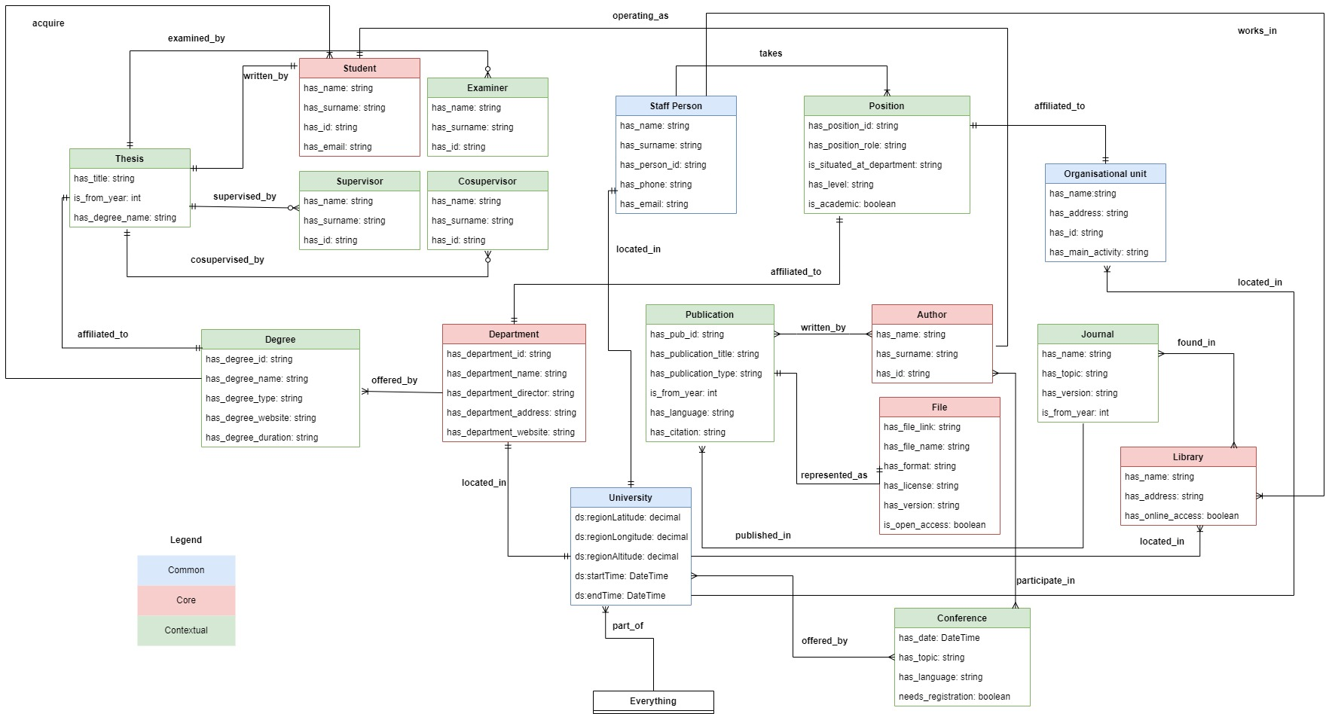
Informal Modeling phase
ER model General

Slide 15
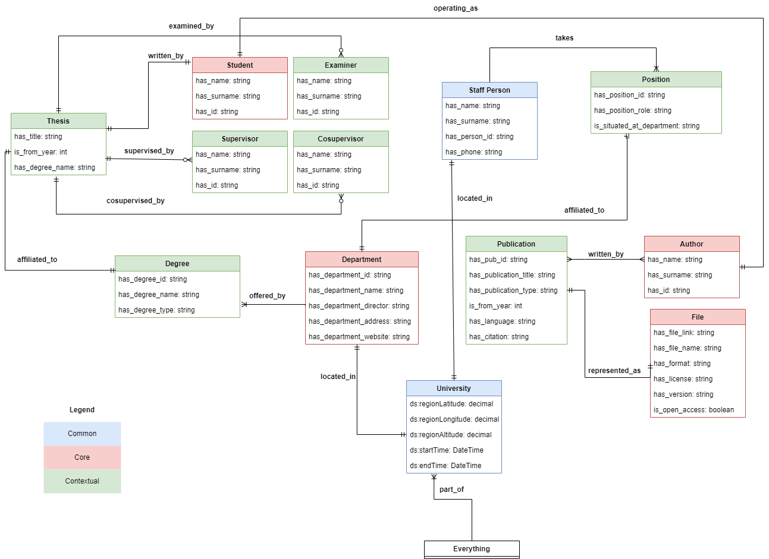
Informal Modeling phase
ER model Specific

Slide 16
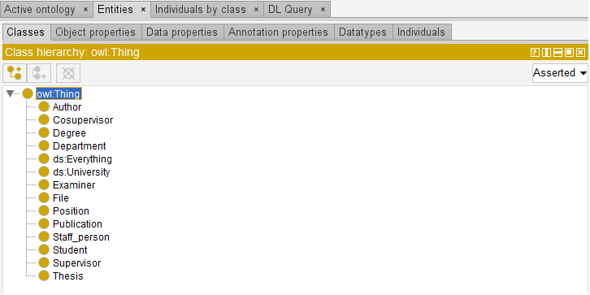
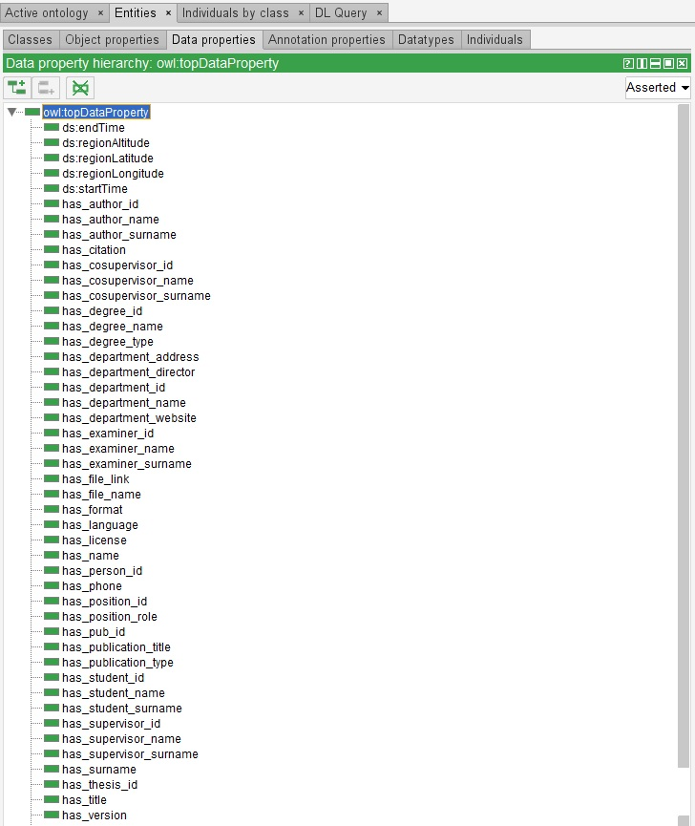
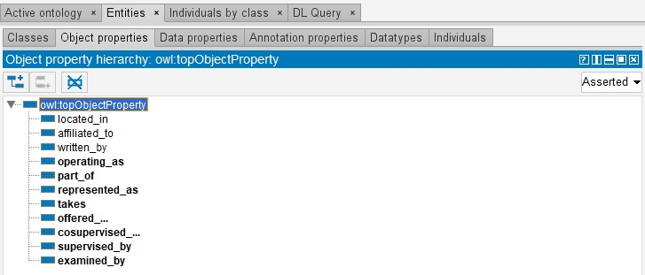
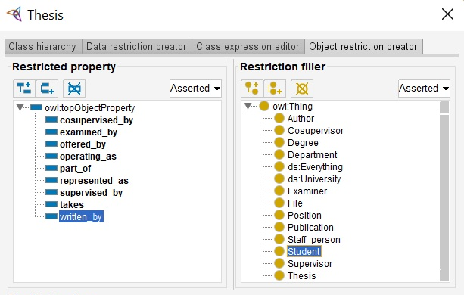
Informal Modeling phase
Protégé Implementation Teleology

Slide 17
Formal Modeling

Slide 18
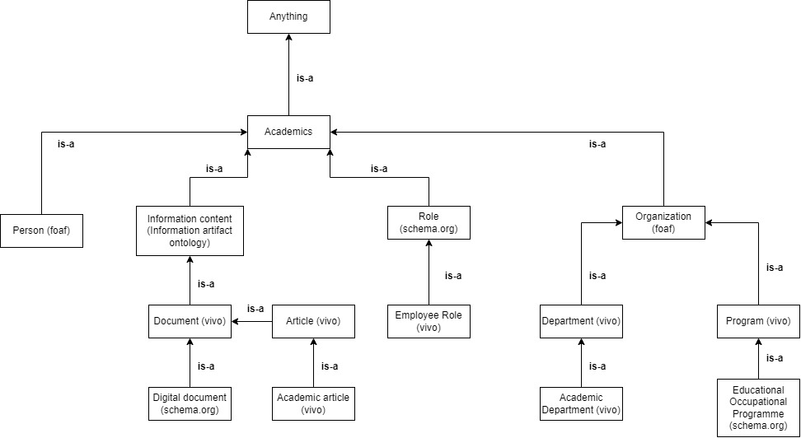
Formal modeling phase
Ontology
Showing hierarchical relations
The higher-level of abstraction knowledge layer
E-types taken from Reference ontology for the purpose of reusability

Slide 19
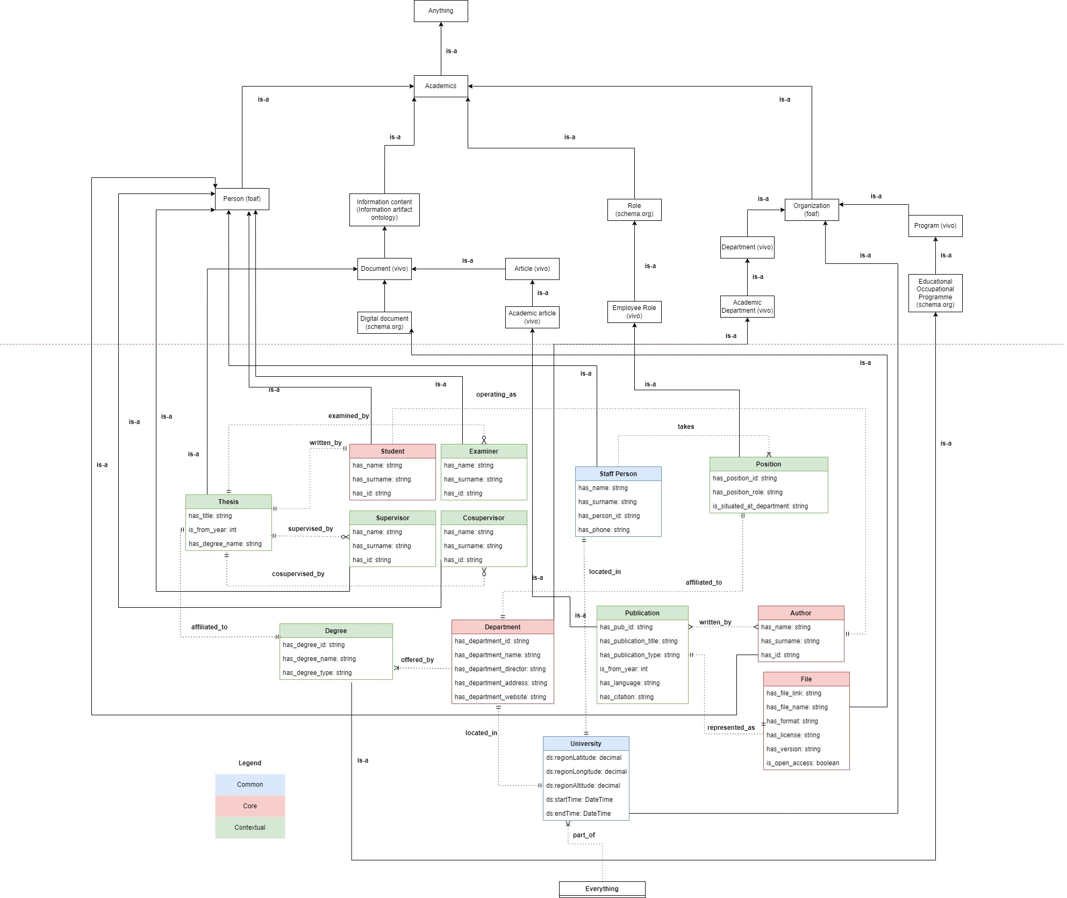
Formal modeling
Teleontology – combining ontology and teleology
How the E-types with their Data and Object properties are mapped to the schema
A complete view of the structure of the KG

Slide 20
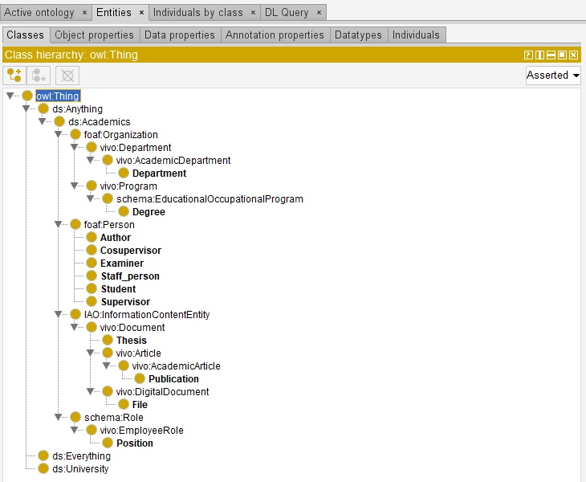
Formal Modeling phase
Protégé Implementation

Slide 21
Formal modeling phase
Language annotation
Concepts defined for the use of this KG, which enlarge the dictionary of meaning of words
Offered_by
verb
Publication
noun
An abstract, article or paper in a journal or electronic repository
Cosupervisor
noun
Someone who is a secondary supervisor
provide possibility to subscribe to a program/course/event
File
noun
An electronic representation of a document
Has_department_director
noun
Has_license
noun
Kind of permission a certain document has
Has_format
noun
The electronic format of a file
Someone who is the main responsible person for a department
Has_file_link
noun
A reference to access a website

Slide 22
Data Integration. Knowledge Graph Construction

Slide 23
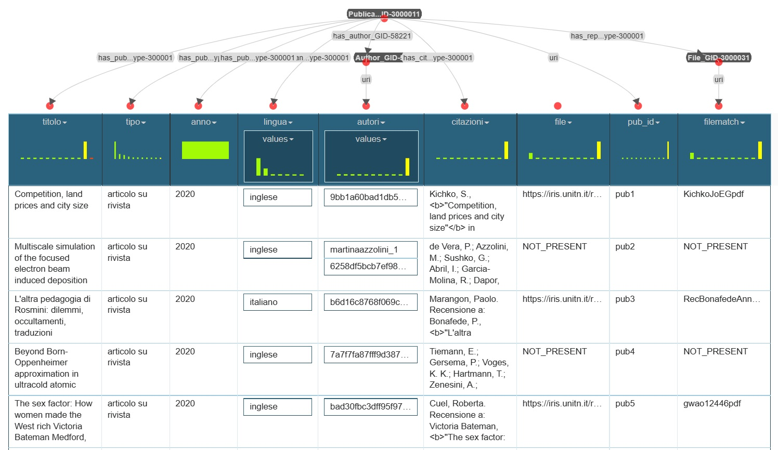
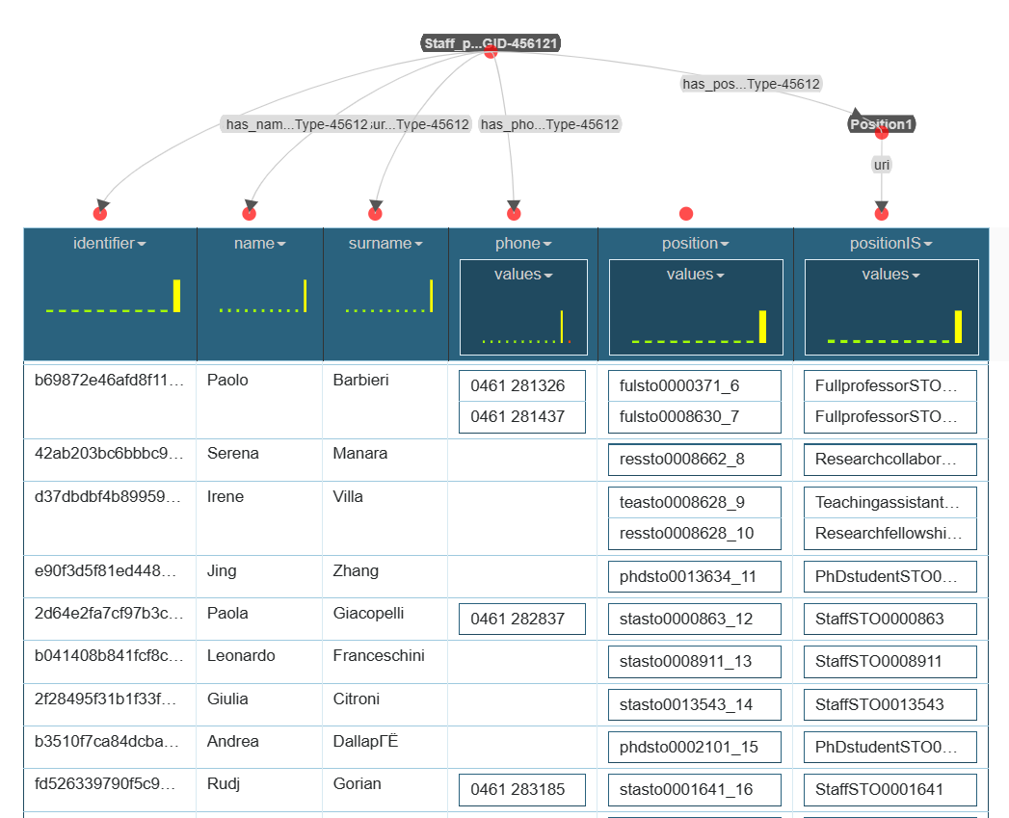
Data Integration. Knowledge Graph Construction
Entity Identification and Semantic Heterogeneity. Entity matching
Some datasets already had IDs (persons, departments)
For others Identification Sets had to be identified from the data (e.g. for Position: role + department)
Since datasets were divided at the beginning, no nested structures
Karma Data Linker efficiently manages these issues

Slide 24
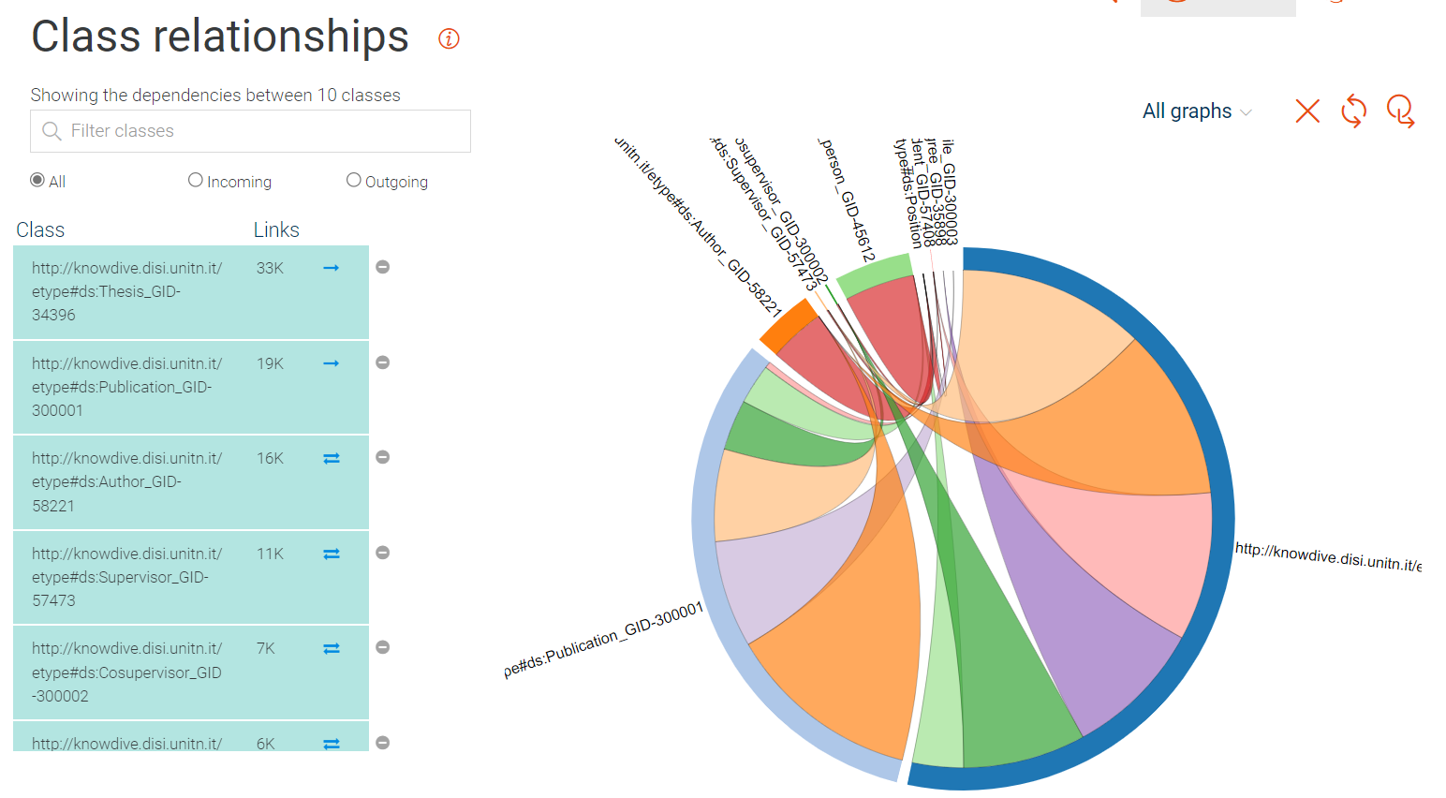
Data Integration. Knowledge Graph Construction
Evaluation. Some statistics
Number of classes
12
Number of DP
2 to 6 per class
Number of OP
11
Links
Most outgoing links from Theses (18K) and Publications (11K)

Slide 25
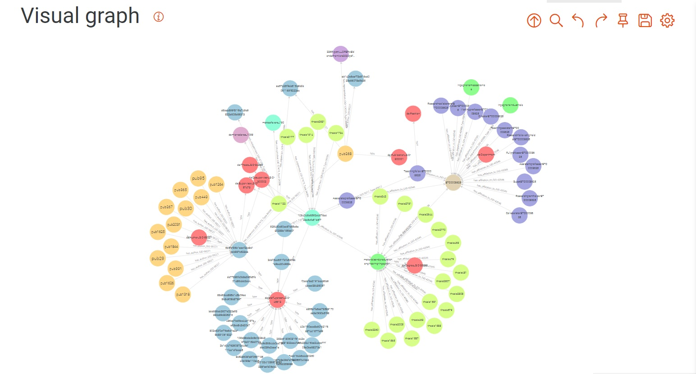
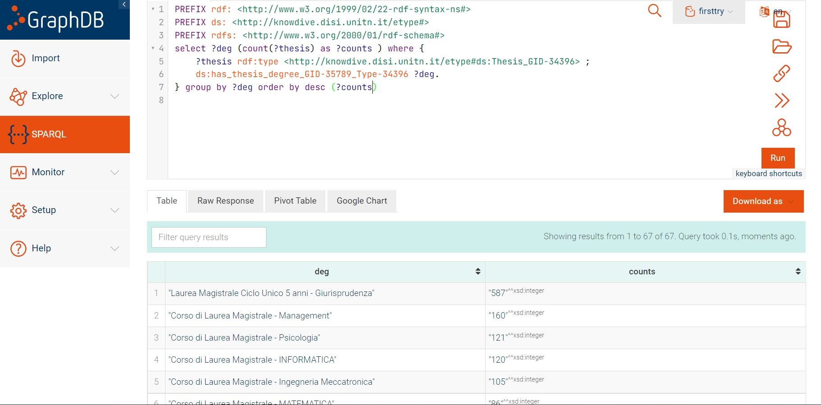
GraphDB
Let’s see a demo of SPARQL queries!

Slide 26
Conclusions

Slide 27
Conclusions and Open Issues
Result
Artifacts as outcomes of the phases
Cleaned and organized datasets
Metadata
Teleology, Ontology, and Teleontology models
Inception sheet
Table with language annotation
Fairly well connected graph.
Two entity types with high number of outgoing links.
Not so much information about persons.
Open Issues
Should Journals and/or Conferences be included in the KG and if yes, how should they be linked?
Is there a way to collect more information about people? This would provide more information about the issue of entity recognition, and if two people are the same.
Each entity person who belongs to different classes has DP coming from all of them and they overlap.
Is there a way to get some kind of indicator for quality of department/degree program?

Slide 28

Thank you!
Q&A

